Slide 1
Appendix A
Scripting and Automation
Introduction to CFX

Slide 2
Overview
Introduction
CFX User Environment (CUE) architecture
State and Session Files
Introduction to Perl
CCL and Perl
“Power Syntax”
Perl subroutines
Macros

Slide 3
Introduction
Need for scripting and automation
  Increase productivity by simplifying repetitive tasks
  Standardize practices
  Save and re-use data
  …

Slide 4
CFX User Environment
CUE is the common development environment for all CFX products
CUE applications employ a client-server architecture
The user interfaces with the “client”, while the “server” processes the data
The most common client is a graphical user interface, but line and batch interfaces also exist
User Input
Client
CCL
Server

Slide 5
GUI Mode
Default mode of operation
Graphical client driven by user input
User loads results, states, runs sessions and macros
User
GUI
CCL
Engine

Slide 6
Line Input Mode
Open session launched from command line or within a script by specifying ‘-line’ flag
  e.g. >cfx5post –line
Client includes viewer and a command line input
CCL objects and commands are input one line at a time
Allows interactive scripts with control outside of script
Line input modes exist for TurboGrid, Pre, Post, Solver (solver uses –ccl flag)
User/Script
Line Input / Viewer
CCL
Engine

Slide 7
Batch Mode
Closed session (not interactive) launched from command line or script
  Direct to engine
No viewer
Session file specified at run time
  Session file may include interactive commands, load states, results, etc.
  Must end with a >quit statement
Script
CCL
Engine

Slide 8
Session Files
Session files contain a list of commands and CCL objects
  Can record the commands executed during a session to a file and then play back the file at a later date or in batch mode
  Can write/modify session files in a text editor
  Produced in Pre, Post, TurboGrid
  Session files can perform actions, for example Input / Output

Slide 9
State Files
State files are a snap-shot of the current state of all objects
  Can be created to save or load a number of objects
  Contain CCL objects-parameter definitions
  Can write / modify state files using a text editor
  Produced in Pre, Post, TurboGrid
  State files cannot perform actions

Slide 10
Introduction to Perl

Slide 11
What is Perl?
Perl is a public domain scripting language that combines the features and purposes of many command languages and tools
  It is a fully featured programming language (even supports Object Oriented programming)
  Has replaced shell scripting, awk, sed, regexp, grep, etc. inside of CFX
  Good text handling and parsing capabilities

Slide 12
Why use Perl?
Advantages
  Powerful, consistent, fully-featured programming language
  System interoperability (Windows/Unix)
  Strong user base & public support
    Many useful Perl modules (subroutine/object libraries) freely available
Disadvantages
  It is an interpreted language
    Can’t ‘hide’ code (sort of…)
    Slow for computationally intensive processes
  Many ways to do the same thing
    Easy to write ‘obfuscated’ Perl

Slide 13
Perl References
Books:
  Introductory
    Randal L. Schwartz, Learning Perl, 1993, O'Reilly and Associates, Inc., ISBN 1-56592-042-2. The "Llama Book".
    Hoffman, Perl 5 For Dummies, 408 pages, IDG Books, ISBN 0-7645-0460-6
  The Perl Bible
    Larry Wall, Tom Christiansen & Randall L. Schwartz, Programming Perl, 2nd Edition September 1996, O'Reilly and Associates, Inc., ISBN 1-56592-149-6. The "Camel Book".
  Advanced Use
    S. Srivivasan, Advanced Perl Programming, 1997, O'Reilly and Associates, Inc., ISBN 1-56592-220-4
Web:
  www.perl.org, www.perl.com, www.perldoc.com
  newsgroups

Slide 14
Perl Example
#!/usr/bin/perl
print “What is your name? “;
$name = <STDIN>;
chomp($name);
if ($name eq “Steve”) {
print “Hi Steve! Good to see you again!\n”; #friendly greeting
} else {
print “Hello, $name. Nice to meet you.\n”; #ordinary greeting
}

Slide 15
Syntax Basics
Perl statements are terminated by a semicolon (;)
Whitespace and indentation do not matter
  Except for making the code readable...
Everything is case sensitive
Comments are preceded by a pound sign (#)
  There are no multi-line comments (e.g. /* [..] */ in C++)

Slide 16
Perl Variables
Variable type is implied, not declared
Leading character determines return type
  Scalars: $…
    Denotes a ‘single’ value
    Can be a number, character string, pointer, array element, etc.
  Linear Arrays: @…
    Elements reference by position
    Elements may be any type (scalar, array, hash)
  Hash (associative array): %
    Elements referenced by lookup (associative)
    Elements may be any type
    Very useful for nested data

Slide 17
Scalar Variables $
Scalars are single valued numbers or strings
Scalar variable names are of the form $varName
  The first character in varName must be a letter
All numbers are treated internally as double-precision floats. Format is flexible:
  1.25, -5.34e34, 12, -2001, 3.14E-5
Variable assignment uses the equal sign (=)
  $pi = 22/7.0 #close enough

Slide 18
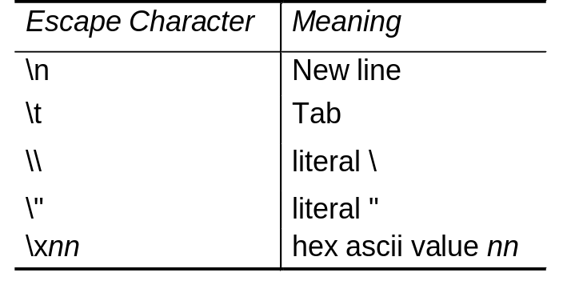
Strings “…”, ‘…’
Strings are a quoted group of characters
  double-quoted (“) and single-quoted (‘) strings are handled slightly differently.
Double quoted strings act a lot like strings in C
  Can include ‘backslash escapes’ to represent special characters.
$greeting = “hello world\n”; # hello world, newline

Slide 19
Arrays (lists)
An array is an ordered list of scalar data
Arrays can have any number of elements
  Perl deals with all memory management issues
  Arrays are zero indexed
The @ sign denotes an array variable
  @evens=(2,4,6,8);
  @numbers = (1..5); # (1,2,3,4,5)
Access a array elements using $listName[indices];
  $four = $evens[1];
  ($four,$five) = $numbers[3,4];

Slide 20
Arrays (lists)
To determine the size of an array, use ‘scalar(@listName)’
Useful array functions:
  push, pop: To add and remove elements from the high end of a list
    push(@list,$newValue) or push(@list,@moreElements)
    $oldValue=pop(@list)
  shift, unshift: To add and remove elements from the low end of a list
  reverse: reverses the order of the elements in a new list
    @backwardList=reverse(@forwardList)
  sort: sorts the elements in ASCII order into a new list
    @ordered=sort(@unordered)

Slide 21
Scalar Variable Operators
Perl uses standard math operators
  addition (+), subtraction (-), multiply (*), divide (/), exponentiation (**), modulus (%)
  increment (++) and decrement (--)
  binary assignment supported (+=,*=, etc.)
    $a = $a + 1; #
    $a += 1; # All are equivalent
    $a++ #
String operators
  concatenation (. or .=)
    “hello” . “world” #gives “helloworld”
    “fred” . “ “ . “wilma” #gives “fred wilma”
  string repetition (x)
    “la” x 3 #gives “lalala”
    “foo” x (4 + 1) #gives “foofoofoofoofoo”

Slide 22
Perl Functions
Perl has many, many built in functions
  Functions for:
    Text processing, numeric functions, process control, list processing, file IO, data processing, etc.
  No real distinction between built-in functions and user-defined subroutines
They all:
  Have a name
  Return a value or list of values
  Can accept arguments
$res = log(123);
$angle = atan2(.5,-.5);
push(@myList,2,4,7);
$value = pop(@myList);
$textBit = substr($myString,3,2);

Slide 23
Logic in Perl
Perl contains a number of control structures (if, else, etc.) based on logic expressions
The following is ‘true’:
  Any string except for “” and “0”.
  Any number except 0.
  Any reference is true
Anything else is false
Tests in control structures can contain any expression or operators and the result is evaluated using the above rules

Slide 24
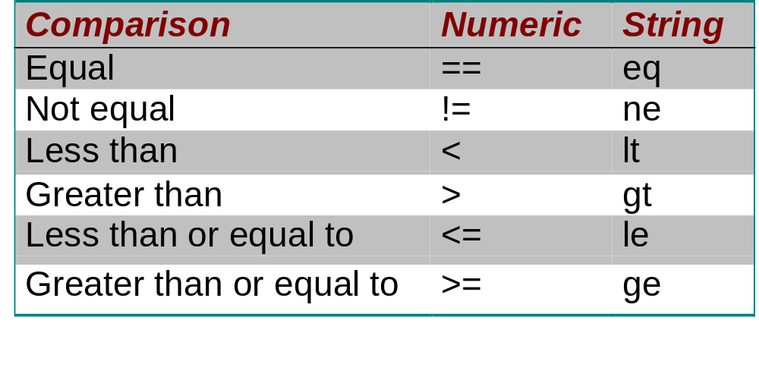
Scalar Comparison Operators
Comparison operators come in numeric and string varieties
Make sure you use the right one…
  e.g. ‘(30 le 7)’ is true. It’s evaluated using ascii precedence

Slide 25
if...
if:
    if (some expression) {
    statement 1;
    statement 2; ...
    } elsif (another_expression) {
    statement 3; ...
    } else {
    statement 4;
    statement 5; ...
    }
    print “How old are you?”;
    $a = <STDIN>;
    chomp($a);
    if ($a < 18) {
    print “Sorry, you’re too young.\n”;
    die;
    } else {
    print “Welcome…\n”;
    }

Slide 26
for… & while…
for:
    for (initial_exp; test_exp; increment_exp) {
    statement 1;
    statement 2; ...
    }
    for ($I = 1; $I < 10; $I++) {
    print “$I\n”;
    }
while:
    while (some expression) {
    statement 1;
    statement 2; ...
    }
    print “How old are you?”;
    $a = <STDIN>;
    chomp($a);
    while ($a > 0) {
    print “At one time, you were $a years old.\n”;
    $a--;
    }

Slide 27
foreach, not, and, or
foreach is a useful for walking through the elements of a list
    foreach $var (@some_list) {
    statement 1;
    statement 2; ...
    }
    @a = (3,5,7,9);
    foreach $number (@a) {
    $number += 2;
    } # @a is now (5,7,9,11);
Any changes to the scalar variable affect the list
‘!’ will negate any logical expression (i.e. ‘not’)
&& is a logical ‘and’
|| is a logical ‘or’

Slide 28
Basic I/O
The connection to an input or output location is called a handle
Filehandles are created using open()
  open for read: open(MYFILE,”infile.dat”);
  open for write: open(MYFILE,”>outfile.dat”);
    Will fail if file exists
  open for append: open(MYFILE,”>>logfile.dat”);
open() returns true/false for success/failure
open(IN,”infile.dat”) || print “Error: couldn’t open file\n”;

Slide 29
Basic I/O
You write to a filehandle by printing to it
      print LOGFILE “Done current task.\n”;
Read from a filehandle by putting it inside <...>
  Returns the next line in the file if assigned to a scalar. An empty string is returned at the end of the file
  Returns all lines if assigned to an array
open(INFILE,”myfile.dat”);
while($line = <INFILE>) {
print “Just read: $line\n”;
}
open(INFILE,”myfile.dat”);
@allLines = <INFILE>;
foreach $line (@allLines) {
print “The file contained: $line\n”;
}

Slide 30
Basic I/O
close(FILEHANDLE) when done with a file
STDIN, STDOUT, STDERR are automatically managed filehandles.
he chomp($a) function removes the last character from a string if it is a newline (\n)
    print “How old are you?”;
    $a = <STDIN>;
    chomp($a);
    if ($a < 18) {
    print “Welcome, my child.\n”;
    } else {
    print “Wow, $a is pretty old.\n”;
    }

Slide 31
External Processes
Handles can also be external apps
Perl can launch and interact with external processes
  System() spawns an external process and waits for it to finish
  Can open a command as a handle, and interact via STDIN. Command is executed when handle is closed.
    $logfile = “logfile.dat”;
    system(“grep -i error $logfile > errors.dat”);
    open(SOLVER,|cfx5solve -def $myRun);
    close(SOLVER); #waits until done to continue

Slide 32
Regular Expressions
Perl can use regular expressions for general text pattern matching and replacement
Complex and ugly, but powerful
    print “Any last requests? ”;
    chomp($a = <STDIN>);
    if ($a =~ /^y/i) { # does the input begin with y
    print “What is it?”;
    <STDIN>;
    print “Sorry, I can’t do that.\n”;
    }
    print “Ready, aim, Fire !\n”;
    $string = “foot fool buffoon”;
    $string =~ s/foo/bar/g;
    # string is now “bart barl bufbarn”
    $line = “X,Y,Z,1,,1.234,34”;
    @fields = split(/\,/, $line);
    # @fields is (“X”,”Y”,”Z”,”1”,””,”1.234”,”34”)

Slide 33
Subroutines
Subroutines are just user defined functions. Declared with ‘sub’
Subroutines return one or more values from a return statement
  … or the value of the last statement if no explicit return.
Invoked by calling subName(args)
    sub subName {
    statement 1;
    statement 2; [...]
    }
    $result = doSomething($a,$b);

Slide 34
Subroutines
Arguments are passed to a subroutine using the @_ list
Must pass lists and arrays by reference
    sub addThreeNumbers {
    ($a, $b, $c) = @_;
    $result = $a + $b + $c;
    return $result;
    }

Slide 35
References
Use ‘\’ in front of a variable to create a scalar reference (pointer)
  $listRef = \@myList;
De-reference by using a variable reference type ($, @ or %)
  push(@$listRef,”new Value”);
Directly access elements in a reference using -> notation
  For arrays: $listRef->[$index]
  For hashes: $hashRef->{$key}
    sub printHash {
    ($hashRef) = @_;
    foreach $key (keys(%$hashRef)) {
    print “Key: $key, Value: “ . $hashRef->{$key} . “\n”;
    }
    }
    %myHash = (“a” => “b”, “c” => “d”);
    printHash(\%myHash);

Slide 36
Variable Scope
By default, all variables have global scope. Can create private variables using ‘my’ specification.
Put ‘use strict;’ in a script to force explicit scoping of all variables
  All variables must be declared using ‘my’ or ‘local’
  Catches mis-typed variable names
    sub addThreeNumbers {
    my ($a, $b, $c) = @_;
    my $result = $a + $b + $c;
    return $result;
    }

Slide 37
Libraries and Modules
Significant benefit of Perl is the ability to re-use other people’s work
You can include a set of subroutines from another file with require ‘filename.pl’
A wide range of modules are publicly available
  www.cpan.org
  e.g. matrix algebra, HTML parsing, database manipulation, graphing, GUIs, 3rd party interfaces

Slide 38
External Perl Scripting
External Perl scripts can be used to drive the CFX-Solver for multiple runs, optimisation loops, etc
The CFX-Solver can be sent CCL through the command line to over-ride local settings
  cfx5solve -ccl <filename | ->
  ‘-’ means read from stdin
  cfx5solve -def duct.def -ccl special.ccl

Slide 39
External Perl Scripting
CFX-Pre, CFD-Post and TurboGrid can also be launched from within a Perl script and automatically run a session file to perform quantitative or graphical post-processing in batch mode
  system(“cfx5post -batch mysession.cse results.res”);
  Or
  open(CFDPOST, |cfx5post –line);
  print CFDPOST …CCL COMMANDS…
  …
  close(CFDPOST);

Slide 40
CCL & Perl
CCL also includes `Power Syntax` as a programming language within CCL
  Indicated by a “!” at the start of the line
Power Syntax is the Perl programming language
  CCL includes Perl
  Full support for loops, if/then/else, subroutines and much more
! $numSteps = 20;
! for (my $i=0; $i<=$numSteps; $i++) {
! $transparency = $i/$numSteps;
BOUNDARY:Default
Transparency = $transparency
END
!}
! $speed = 2.0;
! if ($speed gt 1.5) {
! $turbulence = on;
! }
...
BOUNDARY: inlet1
Normal speed in = $speed [m/s]
! if ($turbulence == on) {
Eddy length scale = 0.001 [m]
! }
END

Slide 41
Power Syntax in the Solver
The Solver accepts CCL – therefore the Solver accepts Power Syntax (Perl)
  Embed Perl in the CCL passed to the Solver
  Parsed as one chunk
  Loop over the objects/parameters modifying the data, the last value wins
  The final state is sent to the solver for execution
Primary use is to define and use variables from external sources to modify existing objects

Slide 42
Power Syntax in CFD-Post
CFX-Pre and CFD-Post operate more interactively than the solver
  CCL is treated as a ‘session’ not a ‘state’
  Can have actions
  Have a number of custom of Perl functions defined
Can create macros (Perl subroutines) that contain power syntax and standard CCL
  Read in subroutine definition from a session file
  GUI definition in header

Slide 43
CFD-Post Perl Functions
See CFD-Post Advanced documentation
Quantitative functions
  All of the CEL extended functions also have power syntax equivalents (e.g.)
    $val = massFlow(location);
    $val = areaAve(variable,location);
  Just return the value
Evaluate the value and units of any single-valued CEL expression
  ($val,$units) = evaluate(“myExpression”);
  Preferred to use this instead of the quantitative functions
    More general and integrated with CEL

Slide 44
CFD-Post Perl Functions
Determine the value of any CCL parameter in the post-processor
  $val = getValue(“OBJECT:NAME”,“Param Name”);
List currently defined subroutines to command window
  showSubs
List currently defined power syntax variables and values
  showVars

Slide 45
Post Macros
Power Syntax macros can be loaded as “macros” in Pre and Post
A macro is basically a session with a user interface
User interface elements are defined in the macro header

Slide 46
Macro Header
Header defines macro name, subroutine and parameters
Choice of parameter type
#Macro GUI begin
#
# macro name = A simple macro
# macro subroutine = mySub
#
# macro parameter = Var
# type = variable
# default = Y
#
# macro parameter = Location
# type = location
# location type = plane
#
# Macro GUI end
! sub mySub {
! ( $variable, $plane) = @_;
!
! print "variable = $variable, plane = $plane\n";
!}

Slide 47
Macro Header
Value | Definition
# macro name = <name> | The macro identifier to appear in the macro combo
# macro subroutine = <subname> | The subroutine to call
# macro report file = <filename> | The file generated by the macro (if any). This enables the “View Report” button, which attempts to load the file in a text/html browser.
# macro related files = <file1>, <file2> | Other related files to load when loading this macro. This is useful when your macro uses subroutines from other files
# macro parameter = <name> #type = <type> #<option1> = <val> #<option2> = <val> #..... | Specifies a GUI widget for a subroutine parameter. The type of widget is determined by the type of parameter. For each type there can be several possible options. The order of the GUI widgets must match the order of the arguments for the subroutine.

Slide 48
Macro Header
Type | Option | Example | Notes
string | default | My String
integer | default range | 10 1, 100
float | default

Slide 49
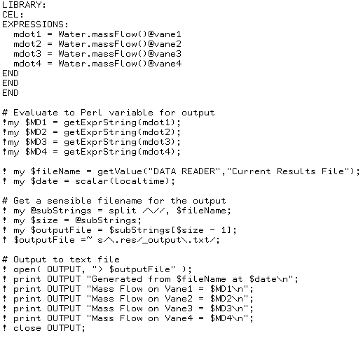
Perl Examples in CFX #1
CFD-Post
  This example exports four mass flow rate values to a text file

Slide 50
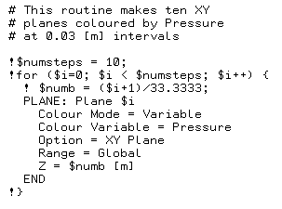
Perl Examples in CFX #2
CFD-Post
  This example creates 10 cut planes colored by pressure through a domain

